Slide 1
404 sleep not found
needfinding report
cmpsc 185
january 23, 2026
404 sleep not found
Year

Slide 2




meet the team
mason le
jayden li
giovanni long
‘28
mill valley, ca
‘28
san jose, ca
‘26
thousand oaks, ca
404 sleep not found

Slide 3
domain selection:
designing for well-being (sleep!)
we all like to sleep
sleep is important for your health. SUPER!
many adults struggle getting enough sleep
404 sleep not found

Slide 4
domain refinement:
young adults who struggle with sleep
we are young adults
the struggling people have the strongest pain
404 sleep not found

Slide 5
finding additional participants
workers with late work schedule
local employees (young adults)
404 sleep not found

Slide 6
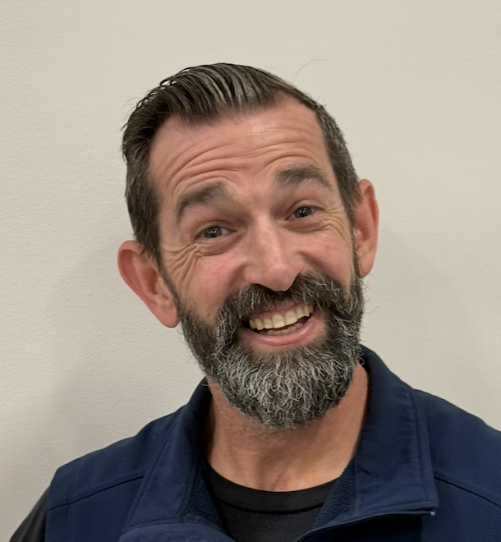
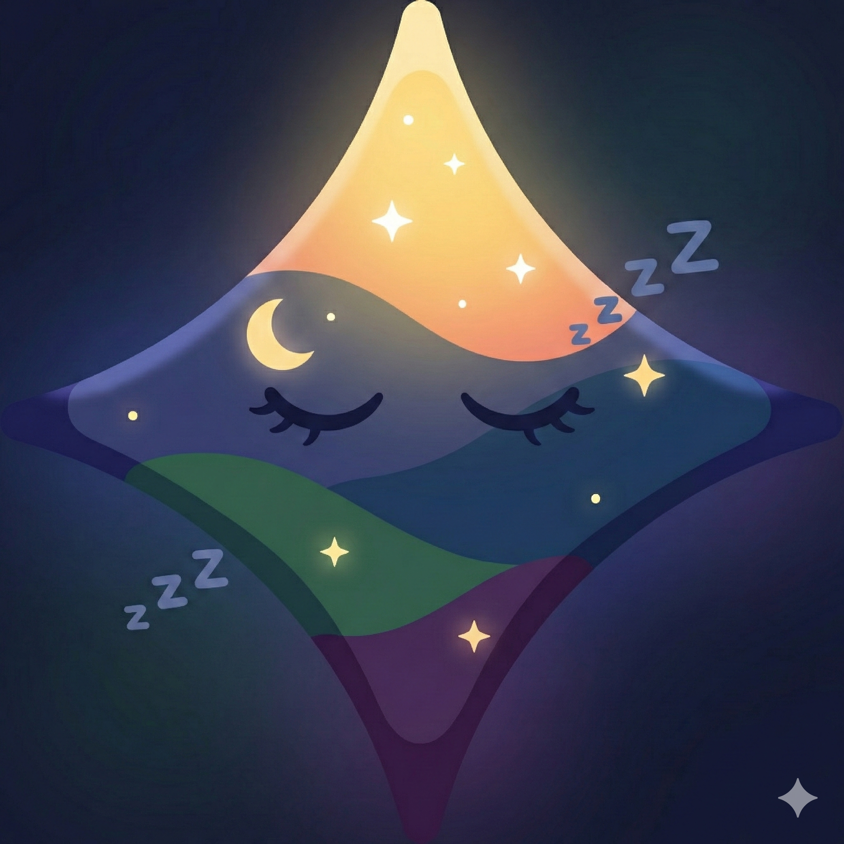

past interviews
john sleep
gemini
buddha
sleep expert
insomniac
clinical psychologist
a worker at an anonymous mattress store! well-trained within the world of mattresses and sleeping (went to sleep information trainings)
an anxious, data-driven perfectionist, needs a sleep routine that distracts its active brain without judging their performance, so that it can let go of the day without feeling out of control
write a brief bio mentioning their background, area of expertise, and what their role in this partnership will be.
404 sleep not found

Slide 7


new interviews
the real john sleep
z
sleep sufferer
former graveyard shifter
pizza worker who has a very inconsistent sleep schedule
ucsb student that chose to work at slodoco from 8 pm - 4 am for the bread
404 sleep not found

Slide 8
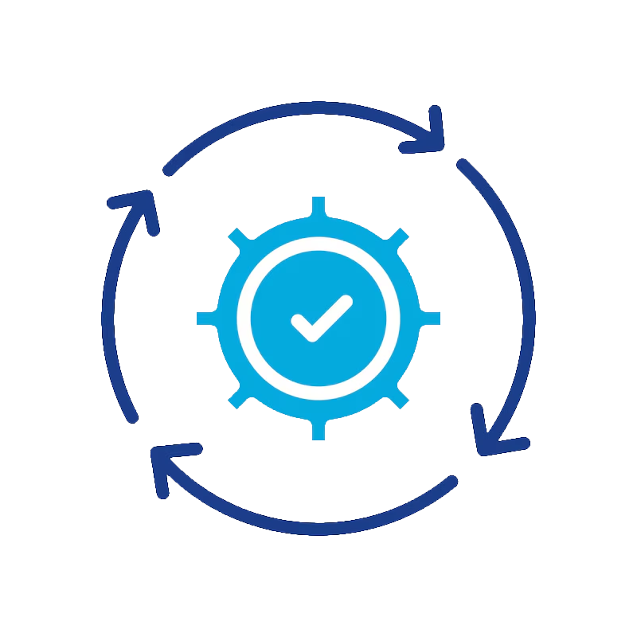

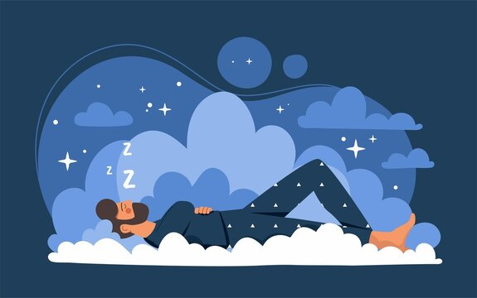
previous learnings
1
2
3
habits and discipline.
important habits and discipline surrounding sleep matters the most.
external factors.
other factors in life general get in the way of quality sleep.
consistency.
consistency is better than optimizing every little thing.
404 sleep not found

Slide 9
the real john sleep
our participants
“it [pineapple] is not that bad [on pizza]”
occupation: pizza worker
interview length: 15 mins
location: his place of work
404 sleep not found

Slide 10
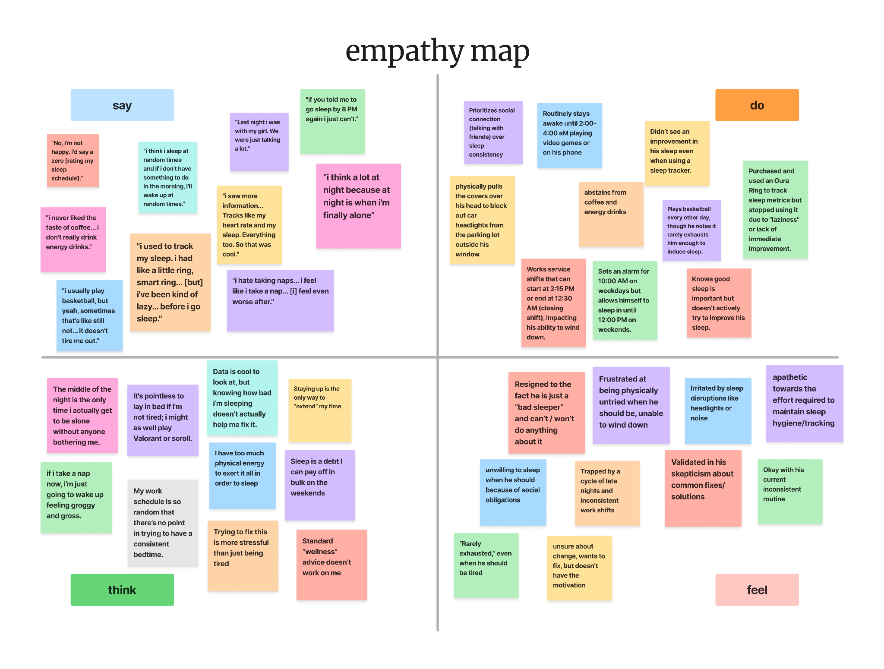

404 sleep not found

Slide 11
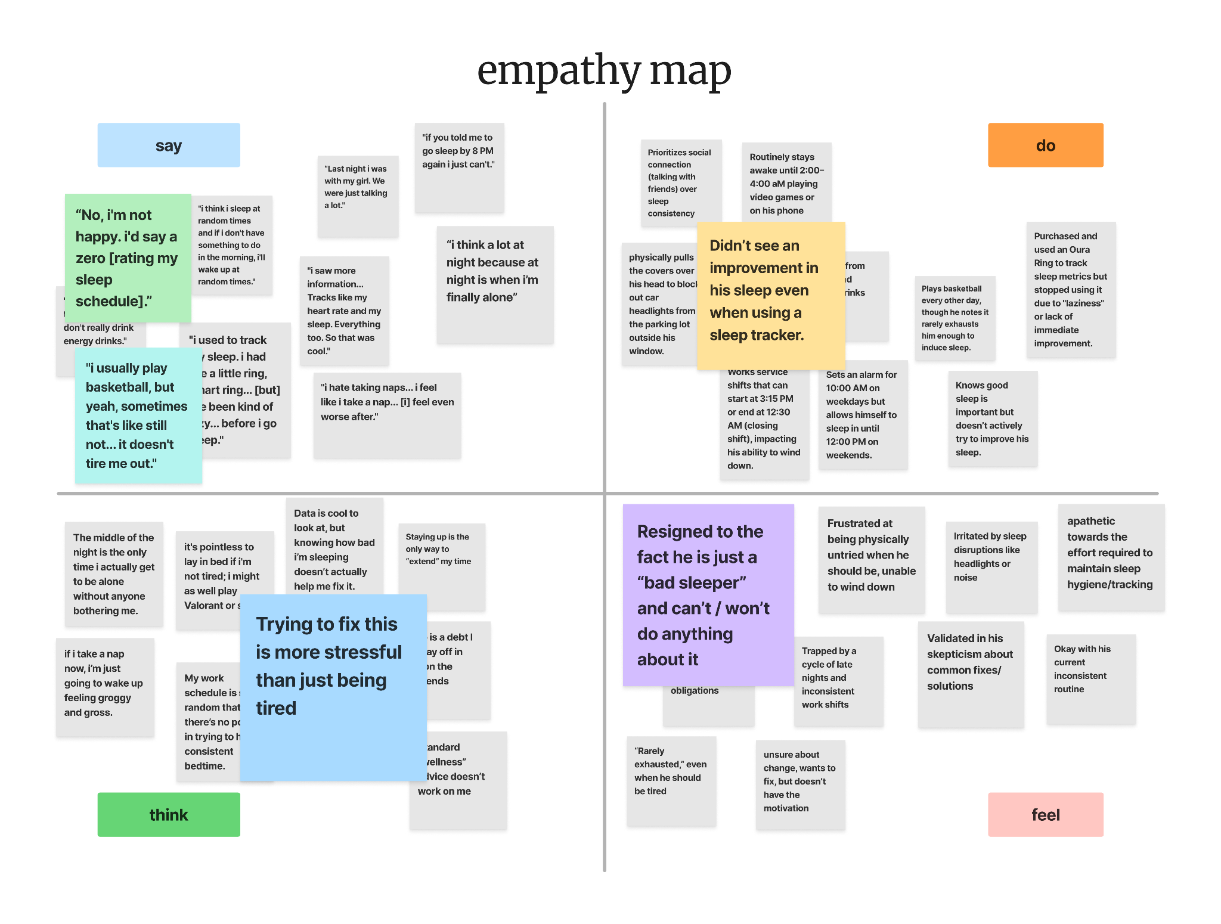
404 sleep not found

Slide 12

insight/need
insight:
need:
404 sleep not found

Slide 13
z
our participants
“i unlocked the 25th hour.”
occupation: donut tosser
interview length: 25 mins
location: pizza pub
404 sleep not found

Slide 14
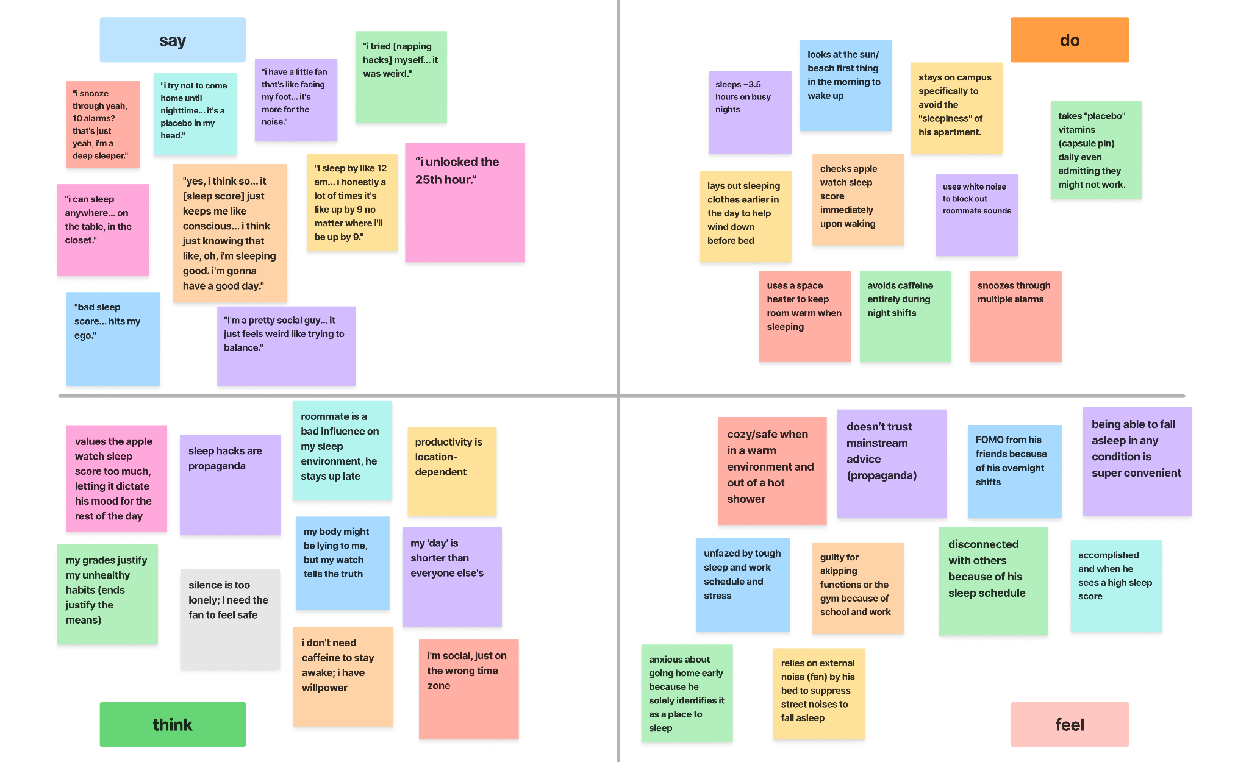
404 sleep not found

Slide 15
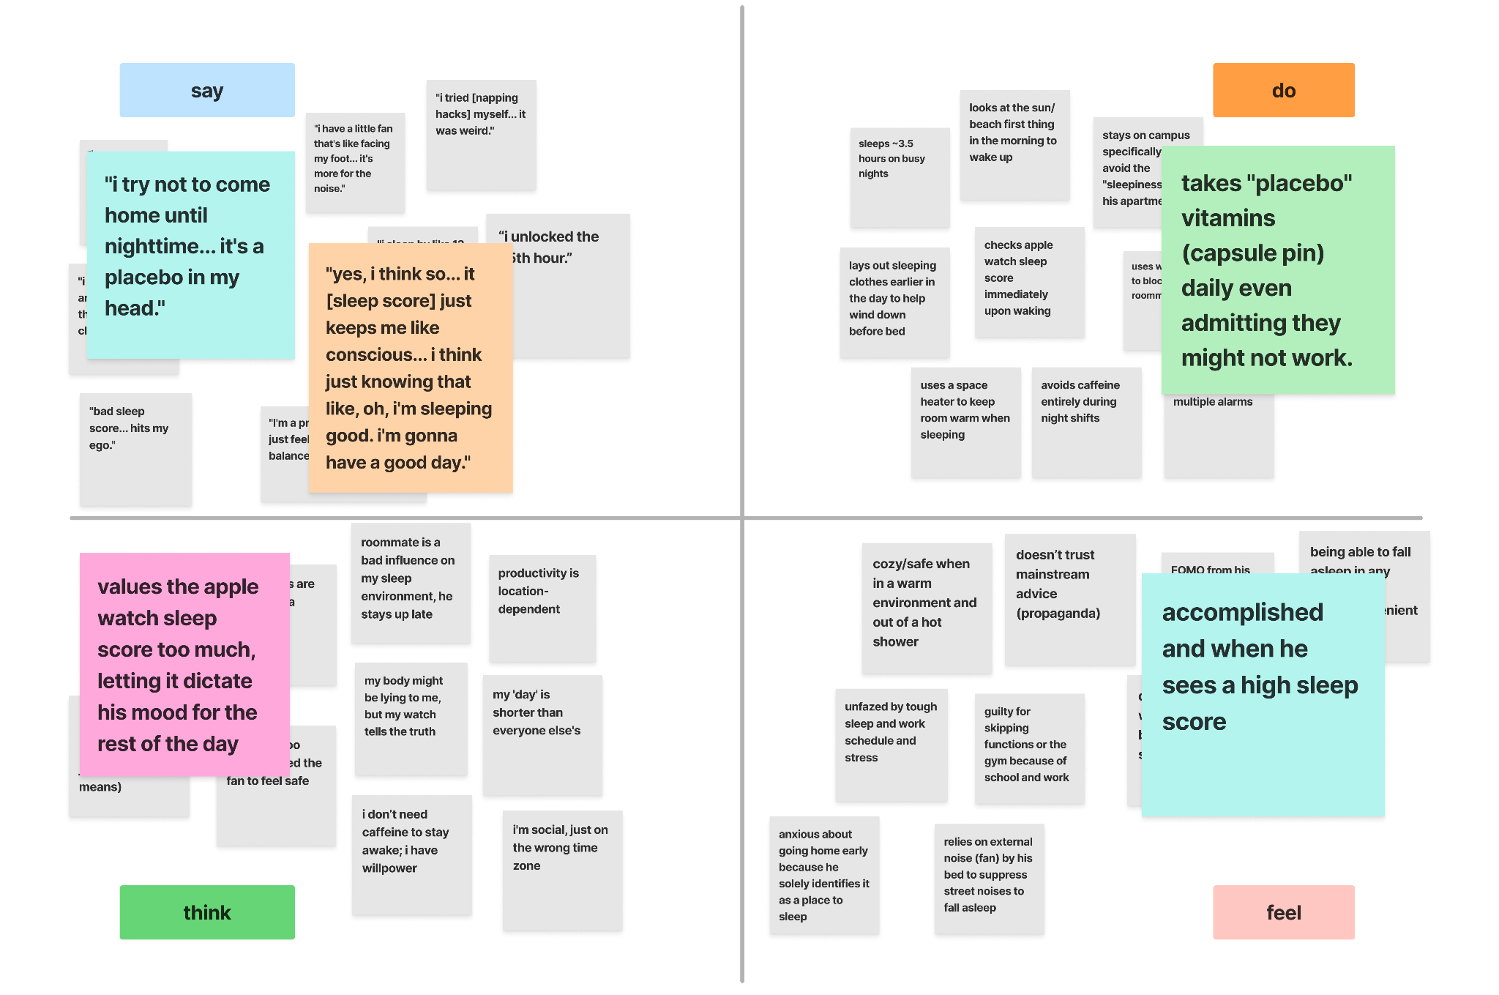
404 sleep not found

Slide 16
insight/need
insight: average bad sleeper knows what they are doing is wrong but does not have the willpower to fix it
need: people who struggle with sleep habits often need better discipline
404 sleep not found

Slide 17
pov development + hmw’s
Our mission
404 sleep not found

Slide 18
the real john sleep
our participants
we met….
a pizza worker with irregular work schedule, social time, and late-night activities who struggles to sleep
we were surprised to realize…
despite having access to tracking tools, sleep assistance, and a good environment, they have not actively tried to change their habits because they are used to poor sleep. “I’ve always been like, ‘oh, I can’t sleep,’ and it’s just like whatever — I gotta deal with it.”
we wonder if this means…
nightly events can make sleep feel uncontrollable instead of something that can change
it would be game-changing…
they felt empowered/incontrol of their sleep with simple realistic strategies
404 sleep not found

Slide 19
assist those with inconsistent sleep schedule
change the outlook that some have that they can’t do anything about their poor sleep
reduce late night distractions
turn sleep related information into motivation rather than just awareness
use consistency cues to replace rigid sleep schedules
encourage those who don’t immediately see results
how might we
build confidence in those struggling for years to change their sleep
design routines for non-fixed sleep schedules (work and social events)
help people who don’t see poor sleep as a problem
build micro-routines that don’t revolve around bed times
support those sensitive to their environment without moving them into a new space
404 sleep not found

Slide 20
z
our participants
we met….
a nocturnal third-year econ student who worked overnight shifts
we were surprised to realize…
he values the data on his apple watch more than his body, allowing a “bad sleep score” to dictate his mood for the rest of the day
we wonder if this means…
health tracking technology intended for wellness and empowerment creates a psychological burden that exhausts users instead
it would be game-changing…
they felt empowered/incontrol of their sleep with simple realistic strategies
404 sleep not found

Slide 21
help those who are most productive at night
provide for those with both late night commitments
and early morning responsibilities
use small cues to signal rest
reduce the fear of missing out when one decides to sleep rather than go out
maintaining healthy sleep without requiring strict routines or set bed times
how might we
design sleep for those who like freedom over structure
frame sleep tracking as a supportive tool rather than a source of pressure or anxiety
help people mentally end their day when their days end differently across the week
push people to care about fixing their sleep without making it urgent or alarming
assist users with managing energy across the day without relying heavily on caffeine
404 sleep not found

Slide 22
top 3 hmw’s
Our values
1
2
3
design routines for non-fixed sleep schedules shaped by work and social commitments
help people mentally end their day when their days end differently across the week?
maintain healthy sleep without requiring strict routines or set bedtimes?
404 sleep not found

Slide 23
solutions & prototypes
Our mission
404 sleep not found

Slide 24
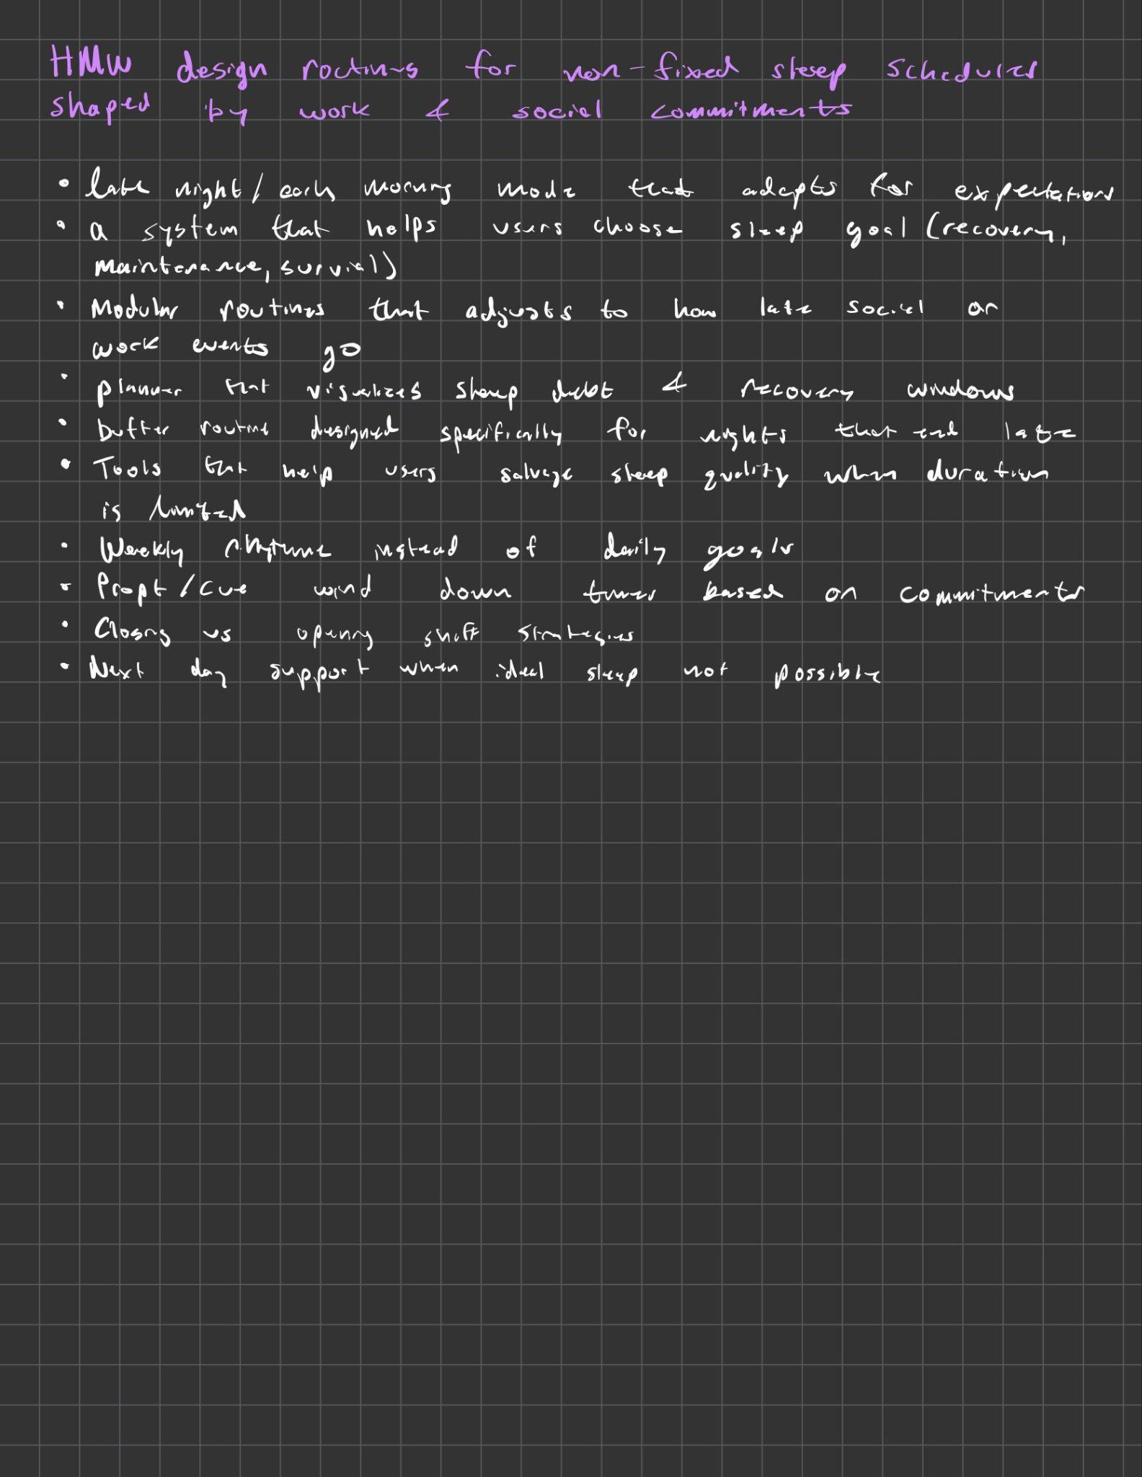
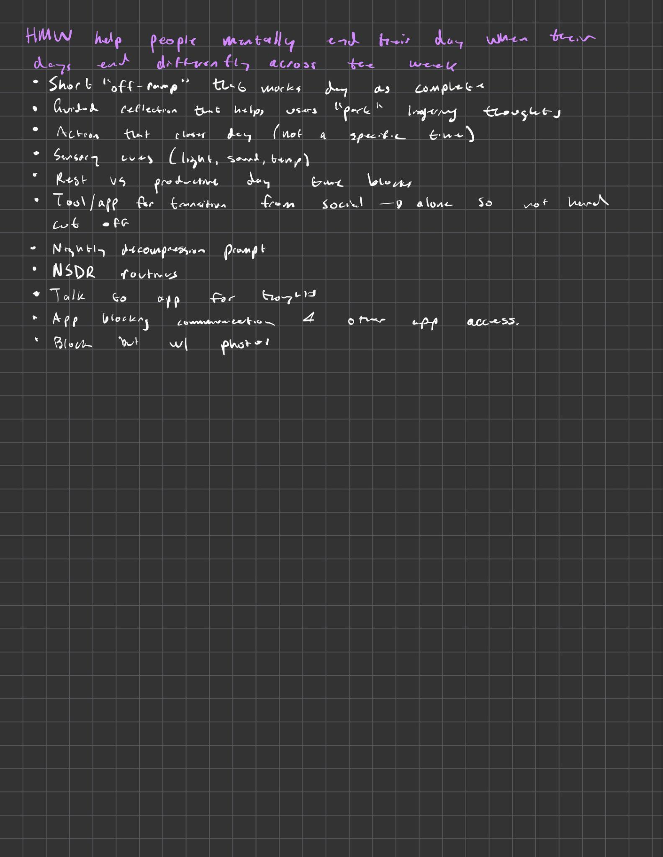
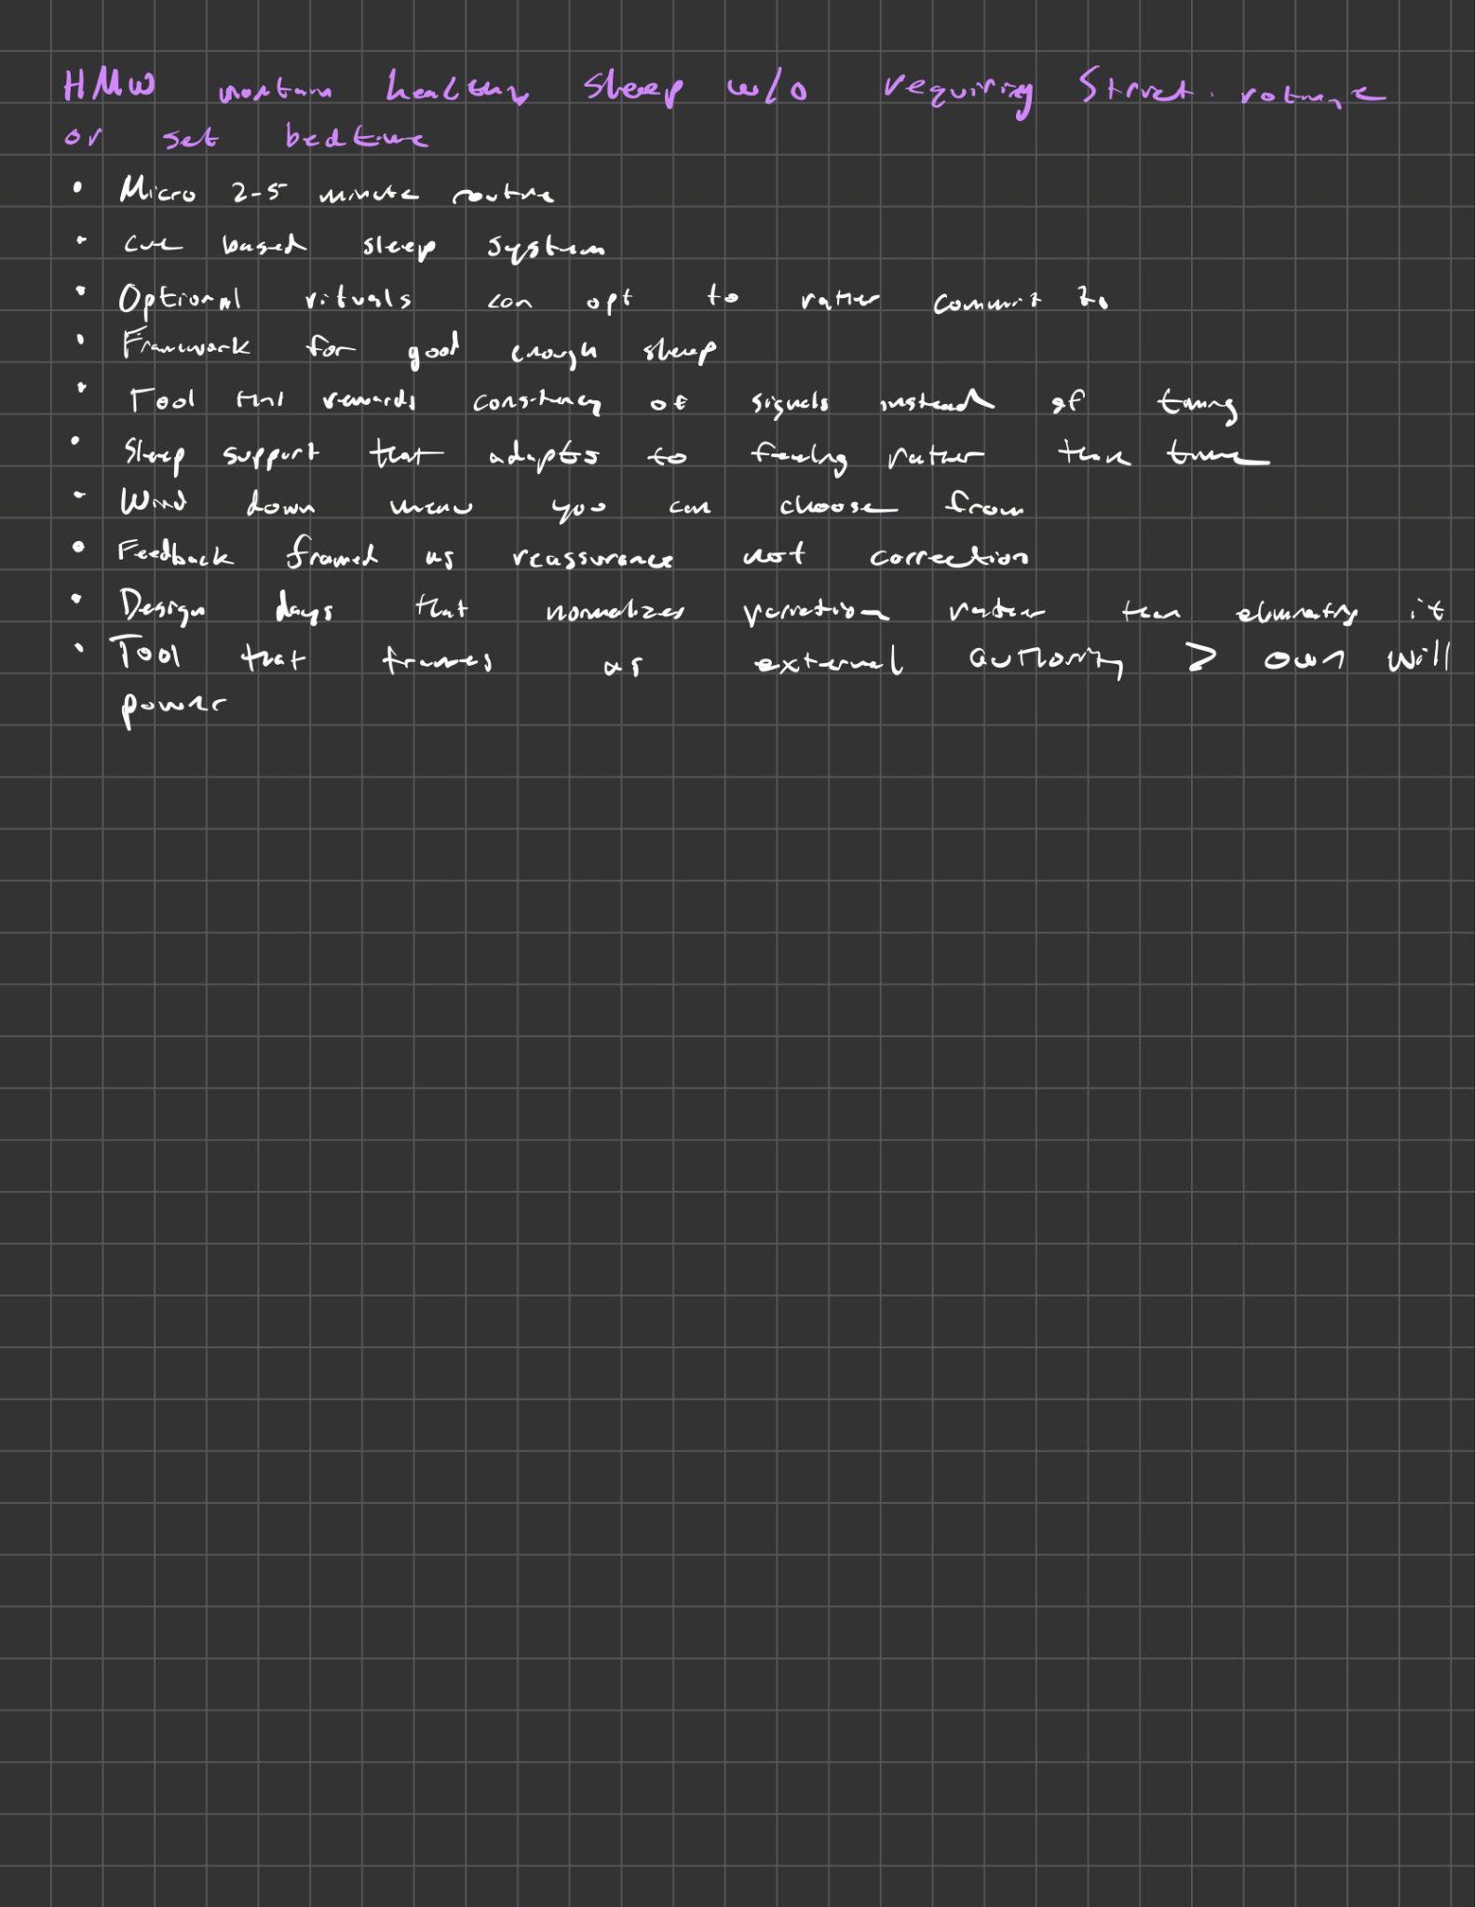
brainstorming
404 sleep not found

Slide 25
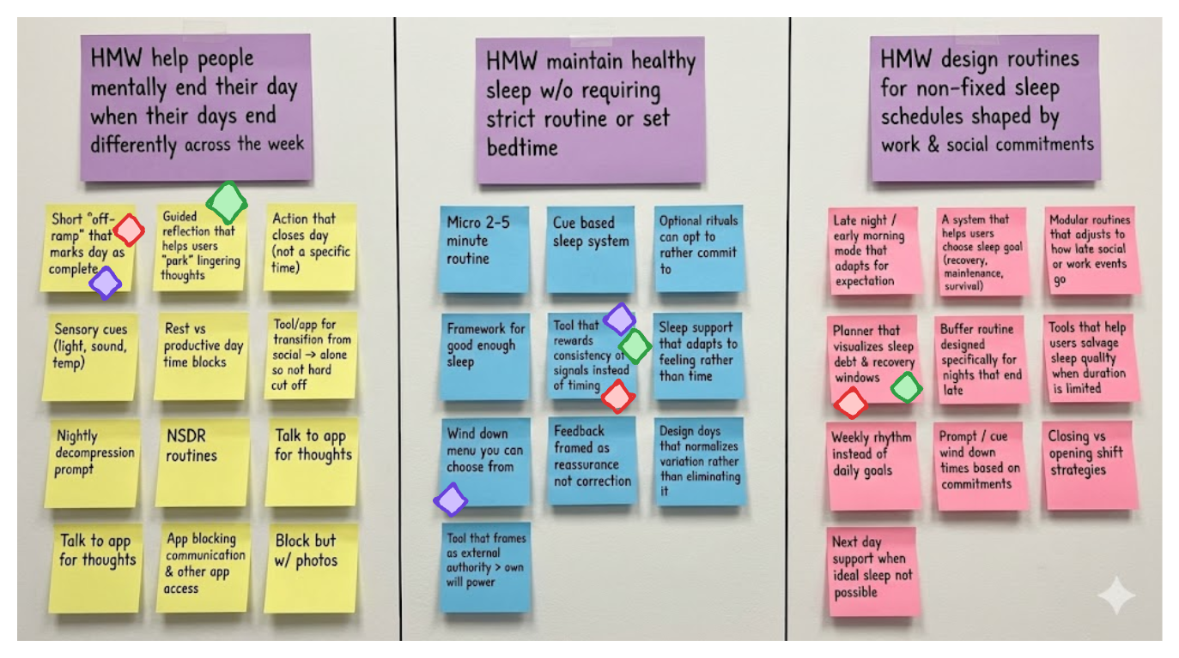
narrowing
404 sleep not found

Slide 26
hmw: help people mentally end their day when their days end differently across the week?
solution:
Short “off ramp” that marks day as complete
provides users with a “save point” to help conclude their day and pick up the next day
404 sleep not found

Slide 27

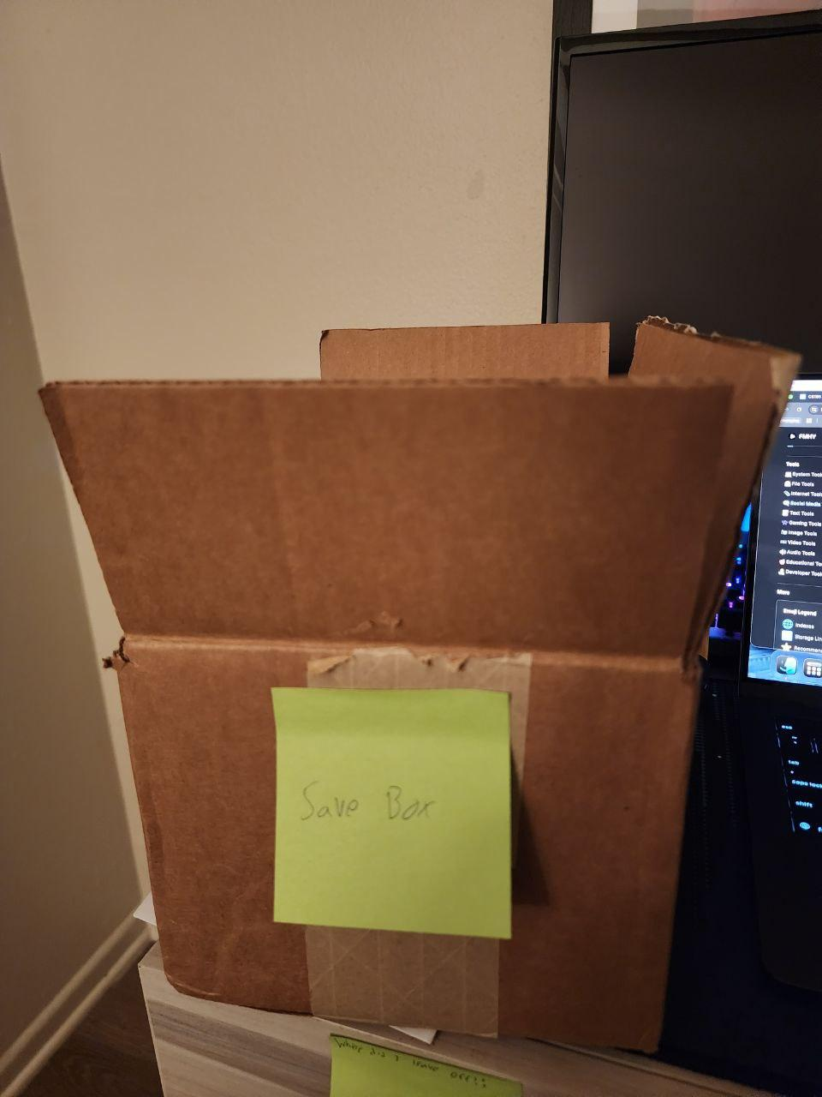
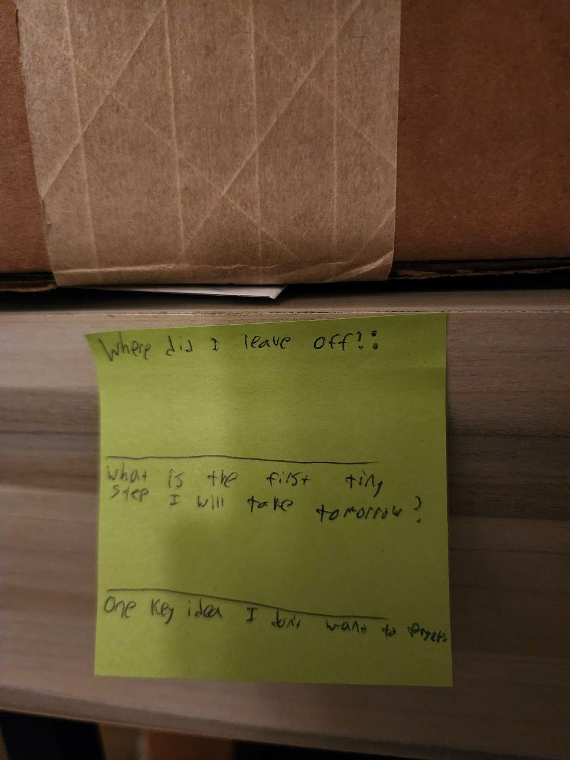
“off ramp” prototype
Critical Assumption:
the primary barrier to ending the day is the fear of losing mental progress. Users will only mentally disconnect if they physically "offload" their open loops into a trusted container
Description:
location: a desk where the participant is working
props:
a save box (cardboard box) and a save card/paper (piece of paper with three prompts)
Where exactly did I leave off? | What is the very first tiny step I will take tomorrow? One key idea I don't want to forget.
execution:
have participants get deep into a complex task (plan a trip to Japan including flights, hotels,
interrupt participants, “the day is over.” don’t try and finish, save here
physically shut the box and put it under the desk/out of sight, move
after distracting participants with another task, if they thought about their original task, and if they felt “safe to stop”
Participants:
residents recruited around apartment complex (similar sleep schedules)
404 sleep not found

Slide 28
results
what worked?
new learnings
what didn’t work?
validity + moving forward
"What is the first tiny step for tomorrow?" prompt; participants reported it instantly lowered the barrier to stopping.
writing down the "one key idea to not forget" successfully neutralized the fear of losing a "mental tab."
users don't just want to "dump" thoughts; they want to stage their return. The value isn't in closing the day, but in trusting the setup for the next morning.
"Closing" is less about hiding work and more about preserving state (like a video game save point).
Users skipped the "Key Idea" field when extremely exhausted, weakening the sense of closure.
Hiding the card in a box felt counterintuitive; users preferred leaving the "Save State" note visible on their desk so it would see it next day
users can “switch off” if they feel their progress is secure.
discard the physical box; develop a digital or notebook-based "Save State" UI that emphasizes the resumption plan rather than just a to-do list.
404 sleep not found

Slide 29
hmw: maintain healthy sleep w/o requiring a strict routine or set bedtime
solution:
tool that rewards consistency of signals instead of timing
404 sleep not found

Slide 30
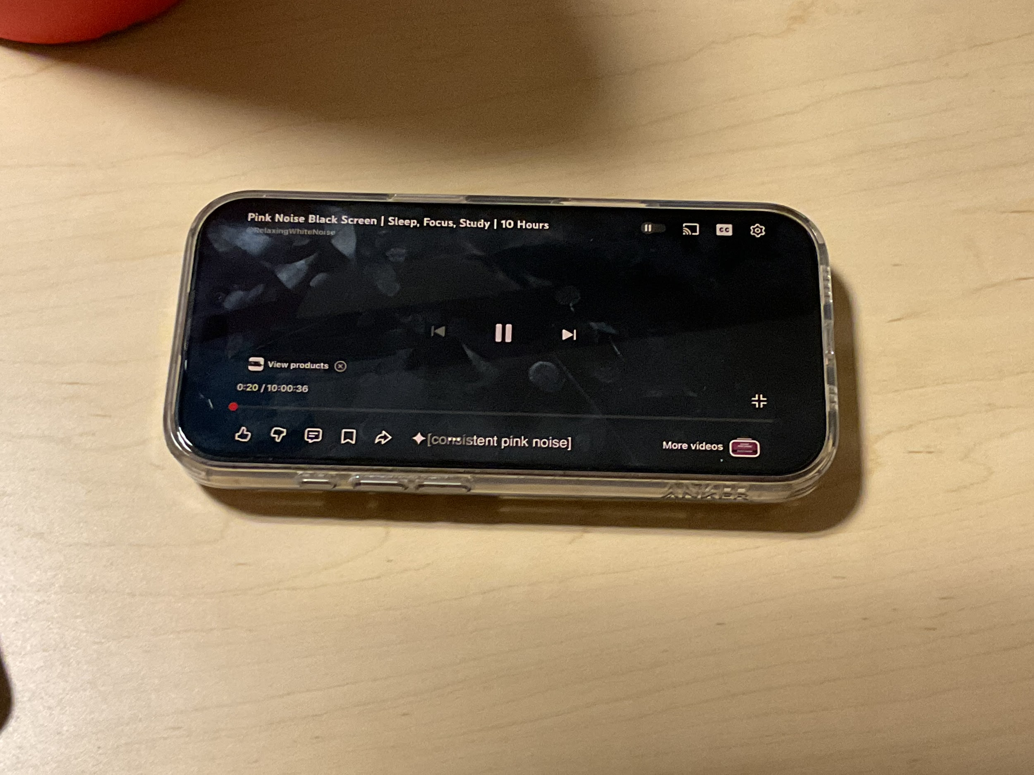
sensory prototype
Let’s work together
Critical Assumption:
users can trigger a “wind-down state” following a specific sequence of sensory cues, regardless of the time of day
Description:
baseline: participants rate their current alertness (1-10)
sequence:
sound: listen to pink noise (120s)
taste: drink warm water/tea (60s) ->
sight: block light with hood/mask
post-test: participants closed eyes (60s) and re-rated alertness
Participants:
who? students with irregular sleep schedules
how recruited? asked students late-at-night in study lounges and library
relevance? represents users with inconsistent bedtimes
404 sleep not found

Slide 31
results
what worked?
new learnings
what didn’t work?
validity + moving forward
audio isolation: pink noise allowed participants to detach from environment
measurable drop: alertness scores dropped 3 points (on avg)
blocking vision amplified effects of the pink noise audio
using the phone to play the audio was a weak point, participants reportedly easily distracted
the “taste” aspect was highly impractical and hard to execute in non-bedroom settings
participants thought prep time was too high effort
sensory cues are able to trigger a “wind-down state”
moving forward, we will remove the “taste” aspect of the routine to reduce friction
404 sleep not found

Slide 32
hmw: design routines for non-fixed sleep schedules shaped by work & social commitments
solution:
Planner that visualizes sleep debt & recovery windows
404 sleep not found

Slide 33
sleep debt visualizer prototype
Critical Assumption:
Visualizing "Sleep Debt" reduces anxiety only if users can immediately visualize "Recovery Windows" to pay it back.
Description:
location: common room table / desk
props: weekly calendar, “debt blocks”, “recovery blocks”
execution: fill out calendar with “debt blocks” representing lost sleep (all nighter, etc) with regular school schedule. Hand participants “recovery blocks” (nap, sleep in, early night) and let the participant fill in the recovery blocks
Participants:
students with irregular sleep schedules (found in library)
404 sleep not found

Slide 34
results
what worked?
new learnings
what didn’t work?
validity + moving forward
The physical act of placing a "Recovery Block" provided immediate relief; users visibly relaxed once the "debt" had a "home."
Treating sleep hours as movable objects made the abstract problem feel solvable (like a puzzle).
Users prefer a "Weekly Balance" view over a daily "Pass/Fail" metric.
The goal isn't "Zero Debt" (which feels impossible), but "Managed Debt" (knowing when the recovery is coming).
Visualizing the solution (recovery) successfully neutralizes the anxiety of the problem (debt).
Develop a "Dynamic Scheduler" that automatically suggests realistic recovery slots based on open windows, ensuring the user focuses on balance rather than loss.
"Trading" social events for sleep felt punitive; users hesitated to sacrifice fun plans just to place a block.
Users initially tried to pay off all debt in one day, leading to unrealistic schedules (e.g., a 14-hour sleep block).
404 sleep not found

Slide 35
evaluating our solutions
Company Name
Quarter Month
Year

Slide 36
“off ramp” / “save point” solution
1: impact
2: reach
3: novelty
high, because it addresses the root psychological anxiety ("fear of forgetting") that physically prevents users from disconnecting.
high, broadly applicable to students, creatives, and knowledge workers who struggle to "switch off" regardless of their schedule.
medium-high, shifts the focus from standard "relaxation" techniques to "productivity assurance," which is a unique psychological pivot.
Company Name
Quarter Month
Year

Slide 37
sensory wind down solution
1: impact
2: reach
3: novelty
medium, highly effective for physiological regulation, but requires higher active effort from the user to set up physical props.
medium, best for users who are responsive to tactile cues and willing to adopt a physical ritual rather than a passive digital one.
high, moves beyond standard tracking or meditation apps by using a specific sequence of physical inputs (temperature, touch) as a control mechanism.
Company Name
Quarter Month
Year

Slide 38
sleep debt visualizer solution
1: impact
2: reach
3: novelty
high, transforms sleep from a daily "pass/fail" failure state into a manageable resource, significantly reducing stress and guilt.
medium-high, specifically targets the massive demographic of irregular sleepers (students, gig workers) whom standard apps ignore.
medium, builds on existing calendar and tracking interfaces but introduces a unique "debt repayment" mechanic that doesn't currently exist.
Company Name
Quarter Month
Year

Slide 39
chosen solution: the "Save State" /
Cognitive Off-Ramp
1
2
3
agenda
evidence
adjustments
community served
participants reported that standard relaxation rituals felt like "chores," but the specific prompt "What is the first tiny step for tomorrow?" instantly lowered their anxiety.
while the physical "box" prototype was found to be cumbersome, we are moving forward in favor of a portable "Save State" system that focuses on resumption rather than just closure.
this solution specifically serves students and knowledge workers with irregular schedules, individuals who view sleep as a threat to their momentum and need permission to stop without feeling unproductive
404 sleep not found

Slide 40
Thank you
404 sleep not found

